Slide 1
INTRODUCTION TO TRIGONOMETRY
Module 3 of 3
Ratna Rathor
AECS 2
Mumbai

Slide 2
Trigonometric Identities

Slide 3
Trigonometric Identities – Definition
An equation involving trigonometric ratios of an angle Ө is said to be a trigonometric identity ,if the LHS of the equation = RHS of the equation for all values of Ө.

Slide 4
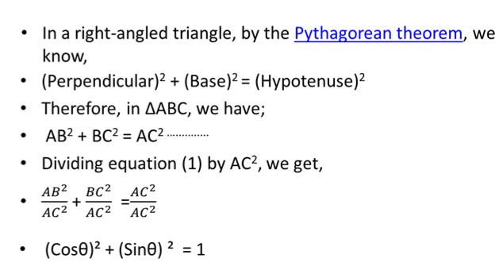
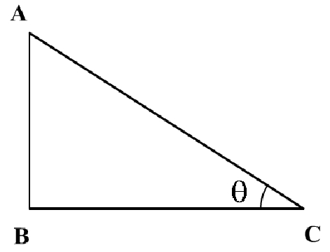

Trigonometric Identities – Derivation
(1)

Slide 5
${Cos}^{2}θ+Sin²θ$ = 1 ( 0° ≤ Ɵ ≤ 90°)
On dividing the first identity by ${Cos}^{2}Ɵ, we get$
$1+Tan²θ$ = ${Sec}^{2}θ$ ( 0° ≤ Ɵ < 90°)
On dividing the first identity by ${Sin}^{2}Ɵ, we get$
$1+Cot²θ$ = ${Cosec}^{2}θ$ ( 0° < Ɵ ≤ 90°)
Notes:
sin²θ

Slide 6
Basic Trigonometric Identities
Basic Identity | Alternative Forms

Slide 7
Prove that
(1 – Cos² A) Cosec² A = 1
Solution:
Taking L.H.S.,
(1 – Cos² A) Cosec² A
= Sin² A Cosec² A (∵ 1 – Cos² A = Sin² A)
= (Sin A Cosec A)² = (l)² = 1 (∵ Cosec A = 1/ Sin A)
= R.H.S.

Slide 8
Prove that
(1 + Cot² A) Sin² A = 1
Solution:
Taking L.H.S.,
(1 + Cot² A) (Sin² A)
= Cosec² A Sin² A { ∵ 1 + Cot² A = Cosec² A}
= [Cosec A Sin A]²
= (1)²= 1 = R.H.S. ( ∵ Cosec A = 1/ Sin A)

Slide 9
THANK YOU

